Slide 1
The loneliness analysis of Canada
By Fabiha Chowdhury

Slide 2
Objective
Data Analysis:
Identify Trends: Analyze the dataset to identify trends and patterns in loneliness across different demographic and socio-economic groups.
Model Training:
Predictive Modeling: Train a machine learning model to predict the likelihood of individuals feeling lonely based on their characteristics.
Feature Importance: Determine which characteristics are most strongly associated with loneliness.
Interactive Visualization:
User Input: Allow users to input their own characteristics and receive predictions on their likelihood of feeling lonely.
Visualization: Provide interactive visualizations to help users understand the data and the model's predictions.

Slide 3
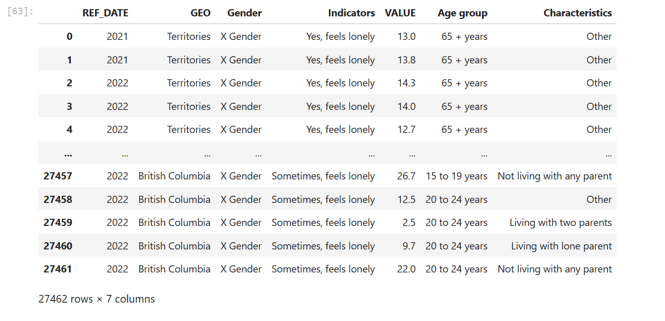
Data
I used 4 data points from 4 different statistics that I collected from Statistics Canada.
This is the final dataframe that I used after a lot of cleaning.

Slide 4
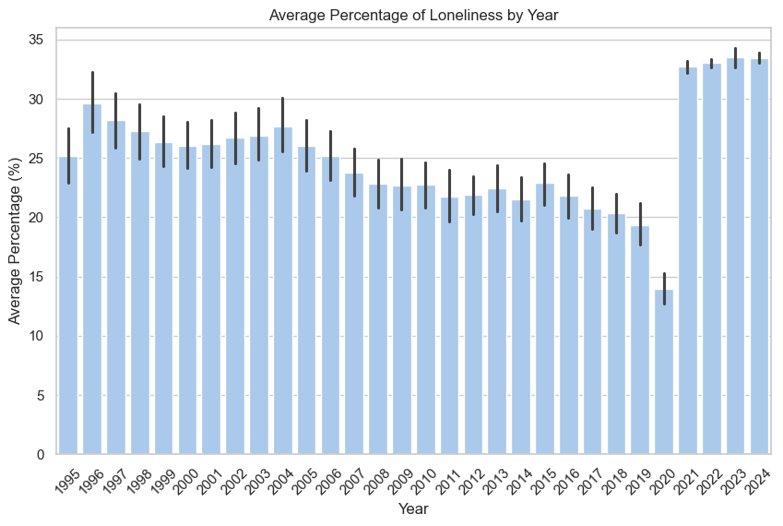
Average Loneliness by year
After 1996, the loneliness decreased.
After the pandemic, there is a high peak of loneliness.

Slide 5
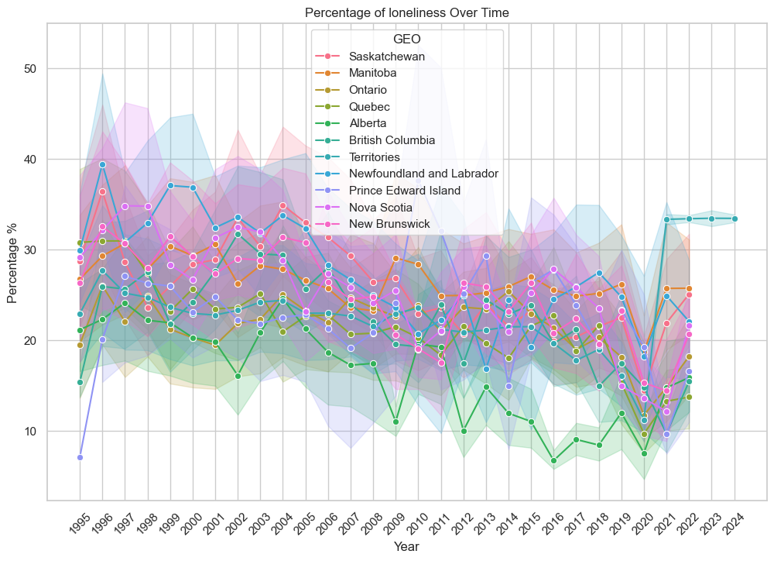
Loneliness over the time
We will be able to see it more clearly in the app.

Slide 6
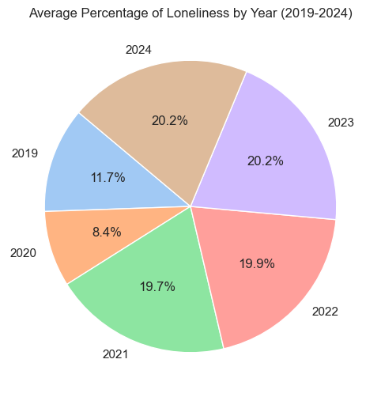
Loneliness in the last five years
In 2020, the pie slice is much smaller.
However, 2023 and 2023 are the biggest slices of the last 5 years.

Slide 7
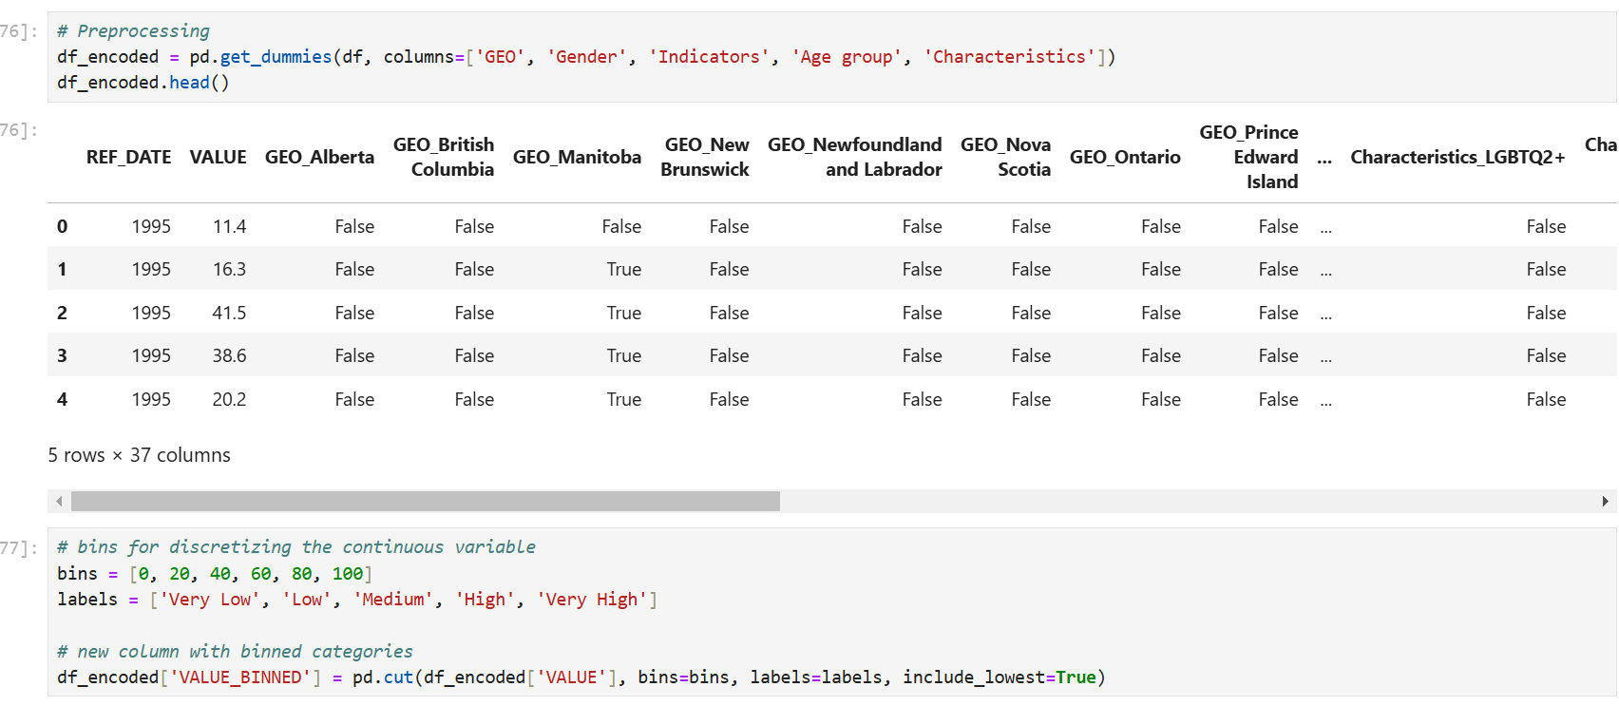
encoding

Slide 8
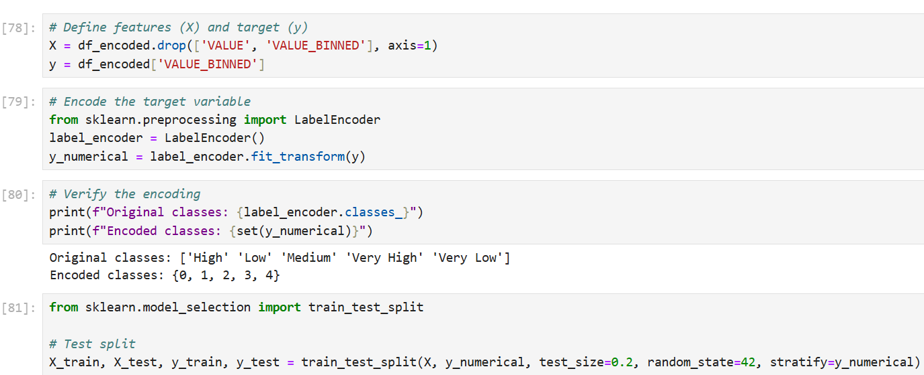
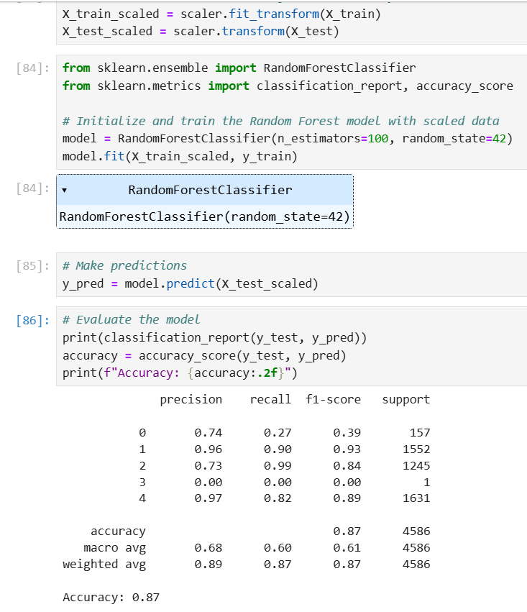
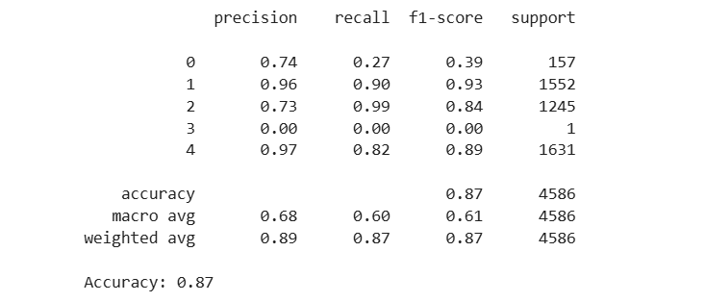
Random Forest Classifier A model accuracy of 87%

Slide 9
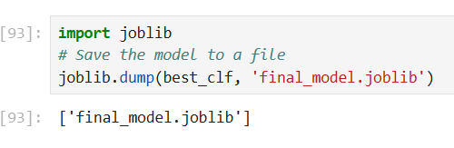
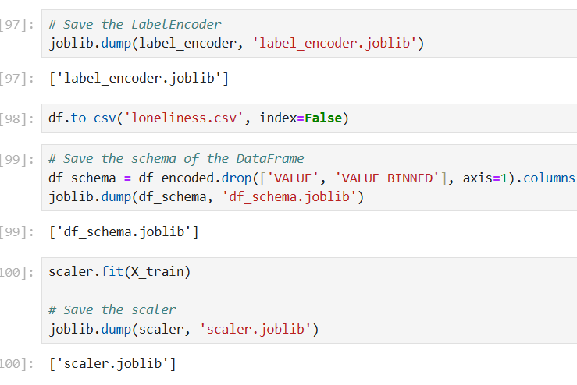
Saved everything using Joblib, then imported in Vscode to create the app.

Slide 10
Why Loneliness
Importance
Sources
Understanding and addressing loneliness in Canada is crucial.
Mostly for improving public health, enhancing social well-being, reducing economic costs, and informing effective policy-making.
By analyzing loneliness trends, we can support targeted interventions and improve the overall quality of life for Canadians.
https://www150.statcan.gc.ca/n1/pub/71-607-x/71-607-x2022007-eng.htm
https://www150.statcan.gc.ca/t1/tbl1/en/tv.action?pid=4510004901&cubeTimeFrame.startMonth=07&cubeTimeFrame.startYear=2021&cubeTimeFrame.endMonth=07&cubeTimeFrame.endYear=2024&referencePeriods=20210701%2C20240701
https://www150.statcan.gc.ca/n1/pub/11-627-m/11-627-m2021090-eng.htm
https://www150.statcan.gc.ca/t1/tbl1/en/tv.action?pid=3710012901&pickMembers%5B0%5D=1.1&pickMembers%5B1%5D=2.1&cubeTimeFrame.startYear=2003&cubeTimeFrame.endYear=2022&referencePeriods=20030101%2C20220101

Slide 11
h
Thank you!
Hope you like my app!

